Slide 1
Data integration and transformation
Data Mining: Concepts and Techniques

Slide 2
Data Integration
Data integration:
  Combines data from multiple sources into a coherent store
Schema integration: e.g., A.cust-id ≡ B.cust-#
  Integrate metadata from different sources
Entity identification problem:
  Identify real world entities from multiple data sources, e.g., Bill Clinton = William Clinton
Detecting and resolving data value conflicts
  For the same real world entity, attribute values from different sources are different
  Possible reasons: different representations, different scales, e.g., metric vs. British units
Data Mining: Concepts and Techniques

Slide 3
Handling Redundancy in Data Integration
  Redundant data occur often when integration of multiple databases
  Object identification: The same attribute or object may have different names in different databases
  Derivable data: One attribute may be a “derived” attribute in another table, e.g., annual revenue
Redundant attributes may be able to be detected by correlation analysis
Careful integration of the data from multiple sources may help reduce/avoid redundancies and inconsistencies and improve mining speed and quality
Data Mining: Concepts and Techniques

Slide 4
Correlation
When two sets of data are strongly linked together we say they have a High Correlation.
The word Correlation is made of Co- (meaning "together"), and Relation
Correlation is Positive when the values increase together.
Correlation is Negative when one value decreases as the other increases.
Data Mining: Concepts and Techniques

Slide 5
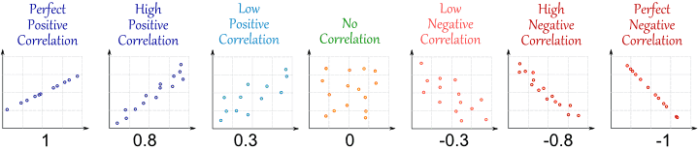
Contd…
Like this:
Data Mining: Concepts and Techniques

Slide 6
Contd…
Correlation can have a value:
  1 is a perfect positive correlation
  0 is no correlation (the values don't seem linked at all)
  -1 is a perfect negative correlation
  The value shows how good the correlation is (not how steep the line is), and if it is positive or negative.
Data Mining: Concepts and Techniques

Slide 7
Example: Ice Cream Sales
The local ice cream shop keeps track of how much ice cream they sell versus the temperature on that day, here are their figures for the last 12 days:
Ice Cream Sales vs Temperature
Temperature °C | Ice Cream Sales
14.2° | $215
16.4° | $325
11.9° | $185
15.2° | $332
18.5° | $406
22.1° | $522
19.4° | $412
25.1° | $614
23.4° | $544
18.1° | $421
22.6° | $445
17.2° | $408
Data Mining: Concepts and Techniques

Slide 8
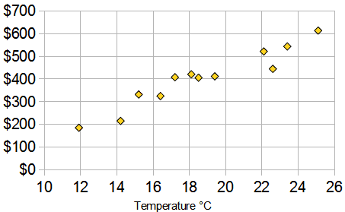
here is the same data as a Scatter Plot
Data Mining: Concepts and Techniques

Slide 9
Contd…
You can easily see that warmer weather leads to more sales, the relationship is good but not perfect.
In fact the correlation is 0.9575 ...
Data Mining: Concepts and Techniques

Slide 10
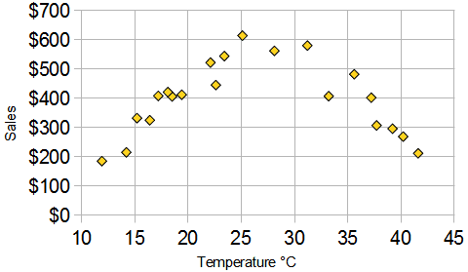
Correlation Is Not Good at Curves
The correlation calculation only works well for relationships that follow a straight line.
Our Ice Cream Example: there has been a heat wave!
It gets so hot that people aren't going near the shop, and sales start dropping.
Here is the latest graph:
The correlation is now 0: "No Correlation" ... !
The calculated value of correlation is 0 (trust me, I worked it out), which says there is "no correlation".
But we can see the data follows a nice curve that reaches a peak around 25° C. But the correlation calculation is not "smart" enough to see this.
Data Mining: Concepts and Techniques

Slide 11
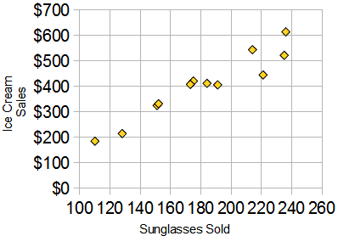
Correlation Is Not Causation
"Correlation Is Not Causation" ... by that I mean: when there is a correlation it does not mean that one thing causes the other
Example: Sunglasses vs Ice Cream
Our Ice Cream shop finds how many sunglasses were sold by a big store for each day and compares them to their ice cream sales:
The correlation between Sunglasses and Ice Cream sales is high
Does this mean that sunglasses make people want ice cream?
Data Mining: Concepts and Techniques

Slide 12
How To Calculate
How did I calculate the value 0.9575 at the top?
Used "Pearson's Correlation".
CORREL() function in Excel or OpenOffice Calc ...
Let us call the two sets of data "x" and "y" (in our case Temperature is x and Ice Cream Sales is y):
  Step 1: Find the mean of x, and the mean of y
  Step 2: Subtract the mean of x from every x value (call them "a"), do the same for y (call them "b")
  Step 3: Calculate: a × b, a² and b² for every value
  Step 4: Sum up a × b, sum up a² and sum up b²
  Step 5: Divide the sum of a × b by the square root of [(sum of a²) × (sum of b²)]
Data Mining: Concepts and Techniques

Slide 13
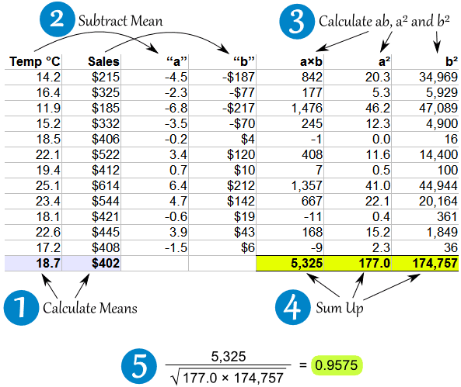
Data Mining: Concepts and Techniques

Slide 14
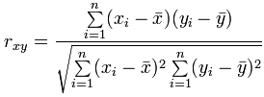
Correlation Formula
Where:
Σ is Sigma, the symbol for "sum up"
is each x-value minus the mean of x (called "a" above)
is each y-value minus the mean of y (called "b" above)
Data Mining: Concepts and Techniques

Slide 15
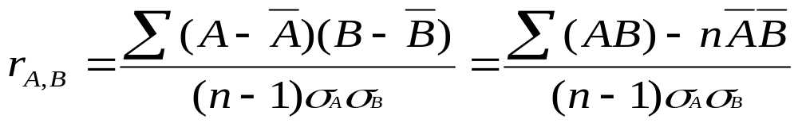


Correlation Analysis (Numerical Data)
Correlation coefficient (also called Pearson’s product moment coefficient)
  where n is the number of tuples, and are the respective means of A and B, σ_{A} and σ_{B} are the respective standard deviation of A and B, and Σ(AB) is the sum of the AB cross-product.
If r_{A,B} > 0, A and B are positively correlated (A’s values increase as B’s). The higher, the stronger correlation.
r_{A,B} = 0: independent; r_{A,B} < 0: negatively correlated
Data Mining: Concepts and Techniques

Slide 16

Correlation Analysis (Categorical Data)
Χ² (chi-square) test
The larger the Χ² value, the more likely the variables are related
The cells that contribute the most to the Χ² value are those whose actual count is very different from the expected count
Correlation does not imply causality
  # of hospitals and # of car-theft in a city are correlated
  Both are causally linked to the third variable: population
Data Mining: Concepts and Techniques

Slide 17
Chi-Square Calculation: An Example
Χ² (chi-square) calculation (numbers in parenthesis are expected counts calculated based on the data distribution in the two categories)
It shows that like_science_fiction and play_chess are correlated in the group
 | Play chess | Not play chess | Sum (row)
Like science fiction | 250(90) | 200(360) | 450
Not like science fiction | 50(210) | 1000(840) | 1050
Sum(col.) | 300 | 1200 | 1500
Data Mining: Concepts and Techniques

Slide 18
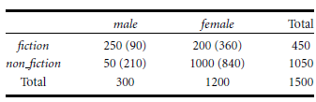


Data Mining: Concepts and Techniques

Slide 19
Data Transformation
The data are transformed or consolidated into forms appropriate for mining.
Data transformation can involve the following:
  Smoothing
  Aggregation
  Generalization
  Normalization
  Attribute/feature construction
  New attributes construction
Data Mining: Concepts and Techniques

Slide 20
Data Transformation
Smoothing: remove noise from data. Such techniques include binning, regression, and clustering.
Aggregation: summarization, data cube construction (e.g., the daily sales data may be aggregated so as to compute monthly and annual total amounts)
Generalization: concept hierarchy climbing where low-level or “primitive” (raw) data are replaced by higher-level concepts.
  (e.g.) For categorical attributes, like street, can be generalized to higher-level concepts, like city or country.
  Similarly, values for numerical attributes, like age, may be mapped to higher-level concepts, like youth, middle-aged, and senior.
Data Mining: Concepts and Techniques

Slide 21
Contd….
Normalization: scaled to fall within a small, specified range such as -1:0 to 1:0, or 0:0 to 1:0.
  min-max normalization
  z-score normalization
  normalization by decimal scaling
Attribute/feature construction
  New attributes are constructed and added from the given set of attributes to help the mining process
Data Mining: Concepts and Techniques

Slide 22





Data Transformation: Normalization
Min-max normalization: to [new_min_{A}, new_max_{A}]
  Ex. Let income range $12,000 to $98,000 normalized to [0.0, 1.0]. Then $73,000 is mapped to
Z-score normalization (μ: mean, σ: standard deviation):
  Ex. Let μ = 54,000, σ = 16,000. Then
Normalization by decimal scaling
Where j is the smallest integer such that Max(|ν’|) < 1
Data Mining: Concepts and Techniques

Slide 23
Contd….
Decimal scaling. Suppose that the recorded values of A range from -986 to 917.
The maximum absolute value of A is 986.
To normalize by decimal scaling, we therefore divide each value by 1,000 (i.e., j = 3) so that -986 normalizes to -0:986 and 917 normalizes to 0:917.
Data Mining: Concepts and Techniques

